Slide 1

DBx Migration Suite

Slide 2

Medallion Architecture
 | BRONZE | SILVER | GOLD | PLATINUM
Purpose | Ingest | Cleanse | Transform | Consolidate
Role | Auditable Source | The Clean Mirror | The Integration Hub | The Presentation Mart
Data Engineers | Ingestion & Audit | Ingestion & Archiving | Transformation & Quality | Define, Build, Optimize & Deliver Models, Visuals & Prompt Response
Data Scientists | Deep Forensic Investigation | Exploratory Data Analysis | Exploration & Feature Engineering | Model Training & Business Consumption
AI Engineers | Not usable | Deep Data Discovery | Building Training Datasets | Enable AI, PBI, ML use cases
Report Engineers | Not usable | Not usable | Query | Build dashboards & visuals
Business Analysis | Not usable | Not usable | Diagnostic analysis, why something happened | Proactive, predictive, automated decision making & forecasting

Slide 3
Reference Architecture — SQL Server → Databricks Unity Catalog Migration Studio | v2.0
14 UI Pages • 85+ API Endpoints • Metadata-Driven Medallion • CDC/DLT • Self-Healing • Auto Infrastructure • Data Quality • Reconciliation
Azure SQL / SQL Server
Migration Studio (Flask)
Databricks Unity Catalog — Multi-Catalog Architecture
4 Source Types:
• Azure SQL Database
• SQL Server (on-prem)
• SQL Managed Instance
• Synapse Analytics
AI Workflow Manager (14 pages)
─────────────────────────
• Pipeline Studio + Job Manager
• MetadataFlow orchestration
• Auto-init from deployconfig
• Notebook gen & deploy
• Databricks job submit + poll
• CDC / DLT mode config
• Self-Healing Bot (auto-fix)
• Progress Tracker (7 steps)
• Reports & Email alerts
REST API
dev_volumes
bronze
silver
gold (future)
UC Volumes (Landing)
Bronze (Raw + Audit)
Silver (Cleansed)
Gold (Business KPIs)
/Volumes/dev_volumes/
hr/landing/{table}
Parquet staging
bronze.hr.{table}
Delta Tables
+ audit cols + DQ
silver.hr.{table}
Dedup + null handling
7-check DQ scoring
Aggregated datasets
BI-ready views
Power BI / Tableau
SPs • Views • UDFs
Metadata Delta Tables • Reconciliation • Logging • DQ Metrics
AI SP Converter
OpenAI / Gemini / Claude
SQL → PySpark notebooks
wf_pipeline_metadata
wf_job_metadata
wf_run_history
wf_watermark_metadata
wf_source_tables
Reconciliation.*
ExecutionLog.*
Auto-Generated Notebooks (Standard PySpark + DLT Mode + CDC)
00_Orchestrator
01_Extract
02_Bronze/DLT
03_Silver
04_Reconciliation
05_ExecutionLog
Chains stages
DLT or Spark
JDBC + Watermark
Parquet → Volumes
Landing → Bronze
Audit + DQ checks
Bronze → Silver
7-check DQ score
Source vs Bronze
SUM per col
Audit trail
Per-job results
Deploy Infrastructure
Migration Studio UI — 14 Feature-Rich Pages
Security
Governance
Reliability
Scale
AutoInfraCreation (Azure SDK)
1. ADLS Gen2 + HNS
2. Access Connector (MI)
3. RBAC role assignment
4. UC Storage Credential
5. External Locations
6. Catalogs + MANAGED LOC
7. UC Volumes (landing)
📊 Dashboard
✨ Data Quality
PAT token auth
Encrypted JDBC
UC RBAC per catalog
MANAGED LOCATION
Reconciliation catalog
Execution logging
Delta versioning
Audit trail
Self-healing bot
Per-stage rerun
DQ scoring (12+)
Restore points
Metadata-driven
DLT + PySpark
Multi-catalog
CDC watermarks
🔄 MetadataFlow
🔀 Schema Comparison
⚡ Pipeline Studio
📐 Reconciliation
📋 Job Manager
⚙️ Settings
85+ API Endpoints
14 UI Pages
12 Python Modules
6 Notebooks
10+ Healing Actions
12+ DQ Checks
Self-Healing Bot
CDC / DLT Engine
📈 Reports
🔧 Convert to PySpark
Error classification
Auto-retry + backoff
Cluster restart
Restore points
Change Tracking CDC
DLT Auto Loader
Watermark-based incr.
Primary key config
📍 Progress Tracker
🚀 Deploy Notebooks
🔐 Audit & Compliance
📦 Data Migration
Technology Stack
End-to-End Data Flow
Key Integration Points
Azure SQL / SQL Server
4 source types (Azure SQL, SQL Server, MI, Synapse)
Azure SQL
JDBC Extract
Volumes Landing
Bronze Delta
DQ + Recon
Silver Delta
Exec Log
• deployconfig.json — all creds + catalog map
Python 3.11 / Flask
Web UI + REST API (85+ endpoints)
• Auto-init on page load (MetadataFlow)
Databricks REST API
Job submit, poll, notebook deploy, cluster ops
• Settings page: Source DB + Metadata loc
UC Volumes + Delta
Landing (Parquet) → Bronze/Silver (Delta)
Standard Mode: Extract → Bronze → Silver (3 stages) | DLT Mode: Extract → DLT Bronze+Silver (2 stages)
CDC: Change Tracking + Watermark-based incremental | Rerun: Per-job rerun from first failure
• Schema Comparison: drift detection
Delta Live Tables
DLT Auto Loader + expectations + CDC
• Data Quality: 12+ checks + __dq_metrics
deployconfig.json
Centralised config — auto-loads on startup
• Reconciliation: SUM validation per col
SQL → Databricks Migration Studio v2.0 | Metadata-Driven Medallion | CDC + DLT | Self-Healing | 14 UI Pages | 85+ Endpoints | deployconfig.json

Slide 4
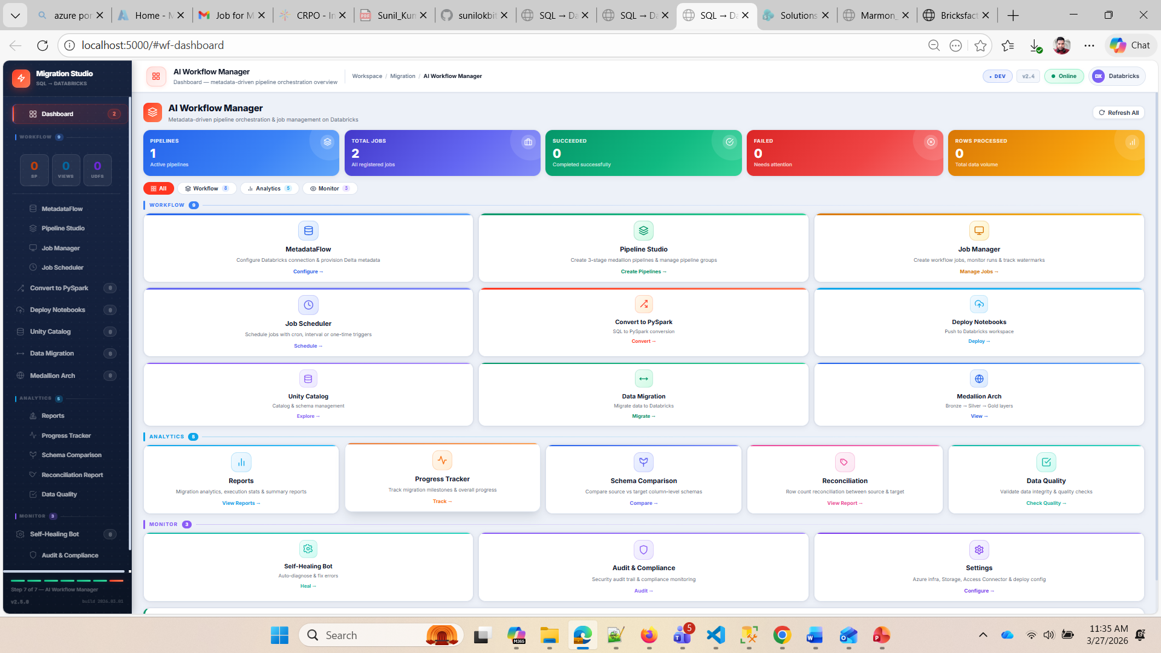

Slide 5
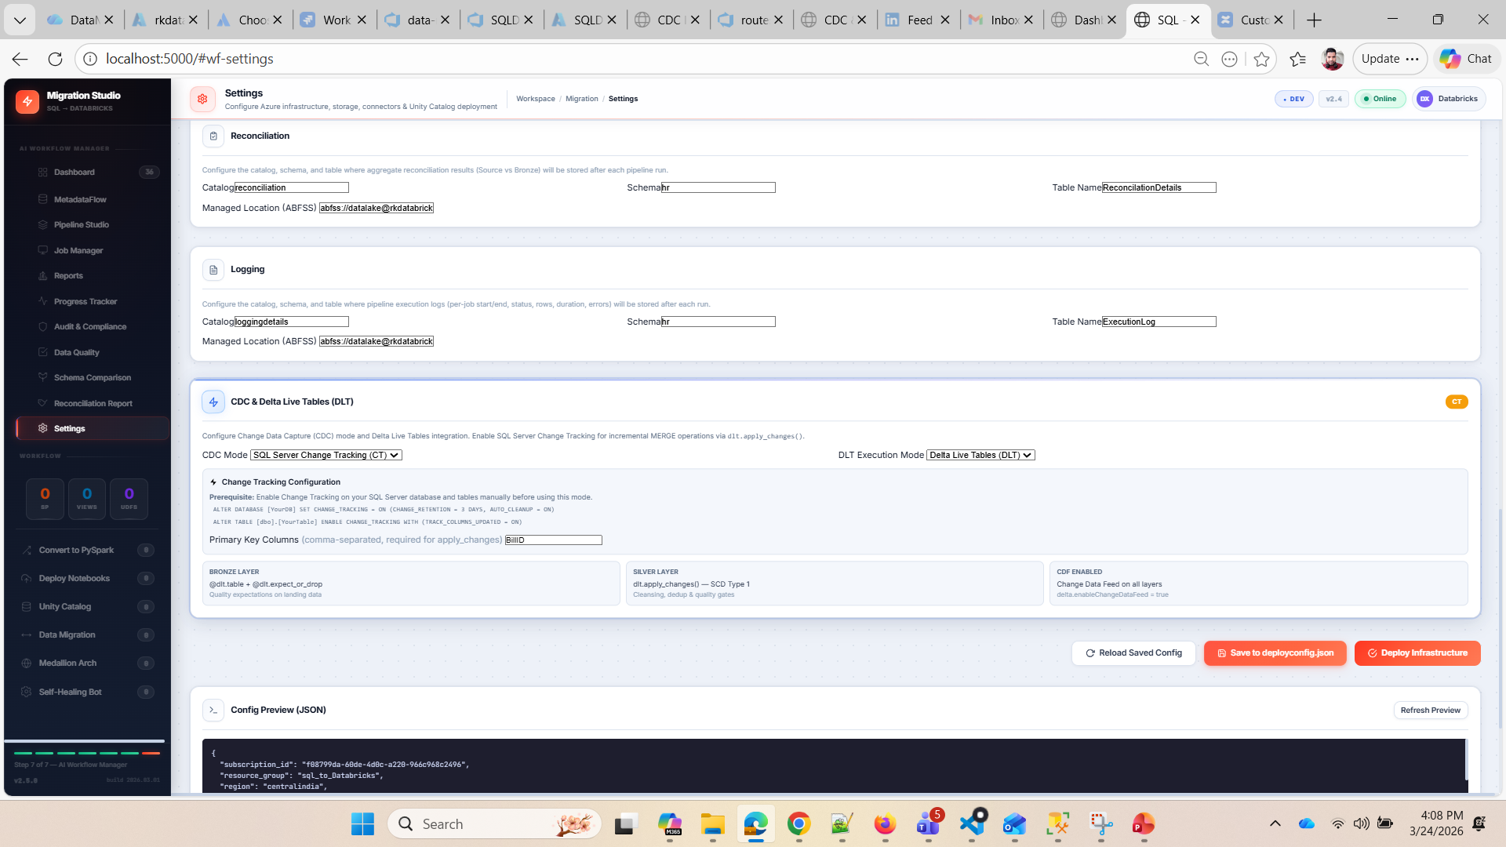
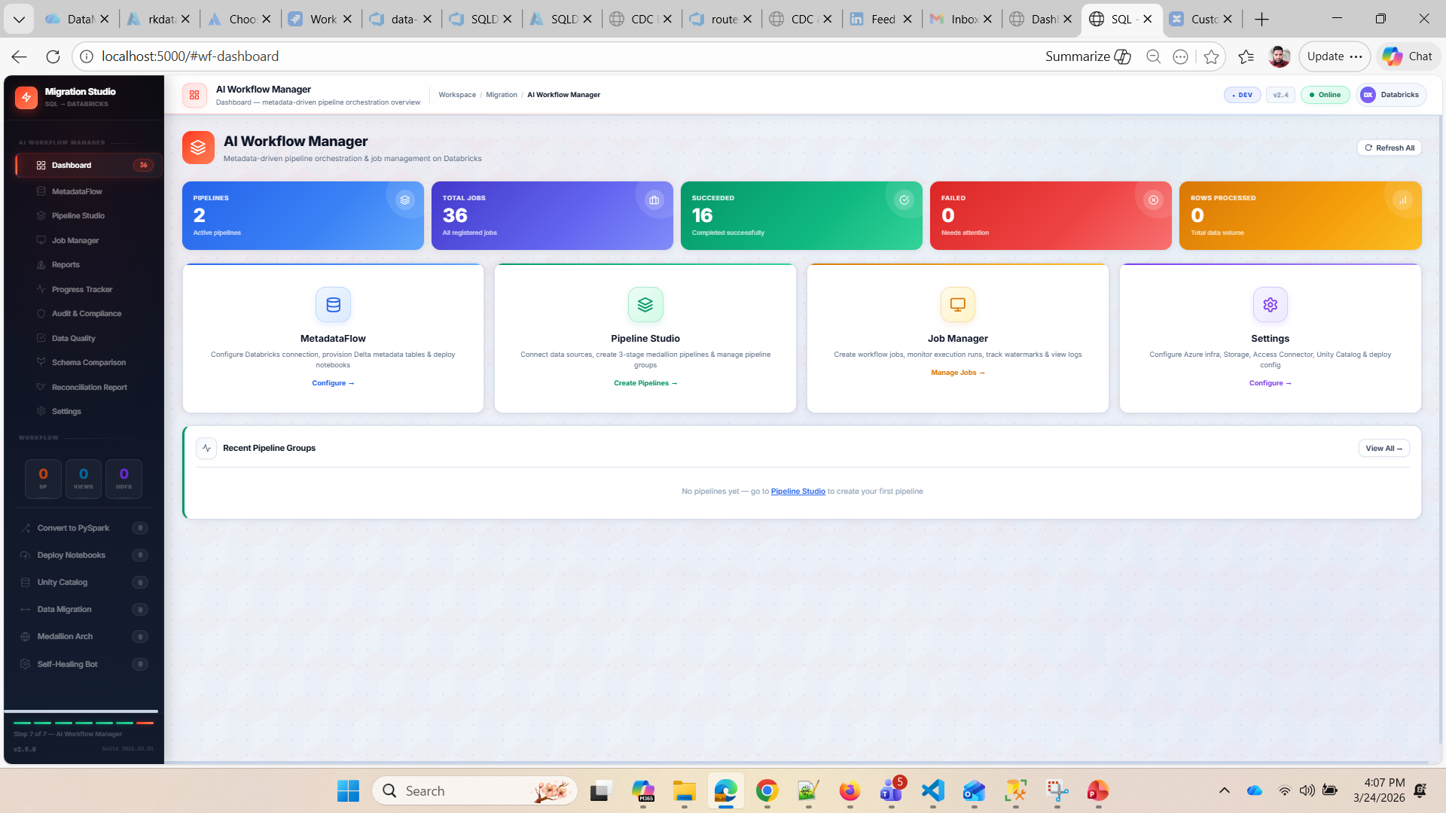
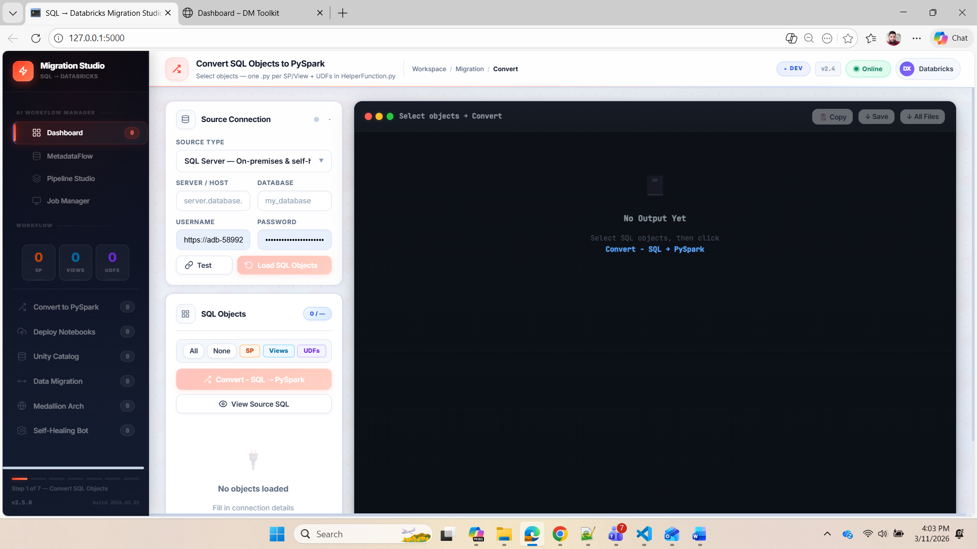

Slide 6
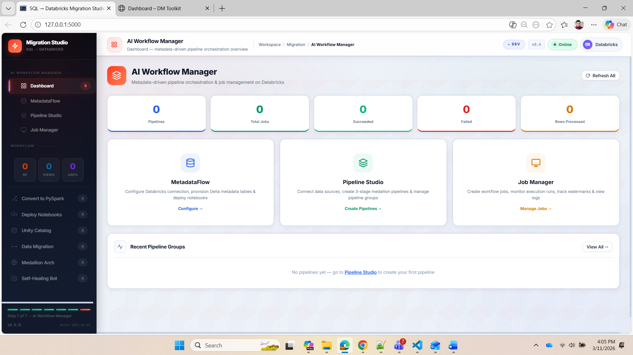
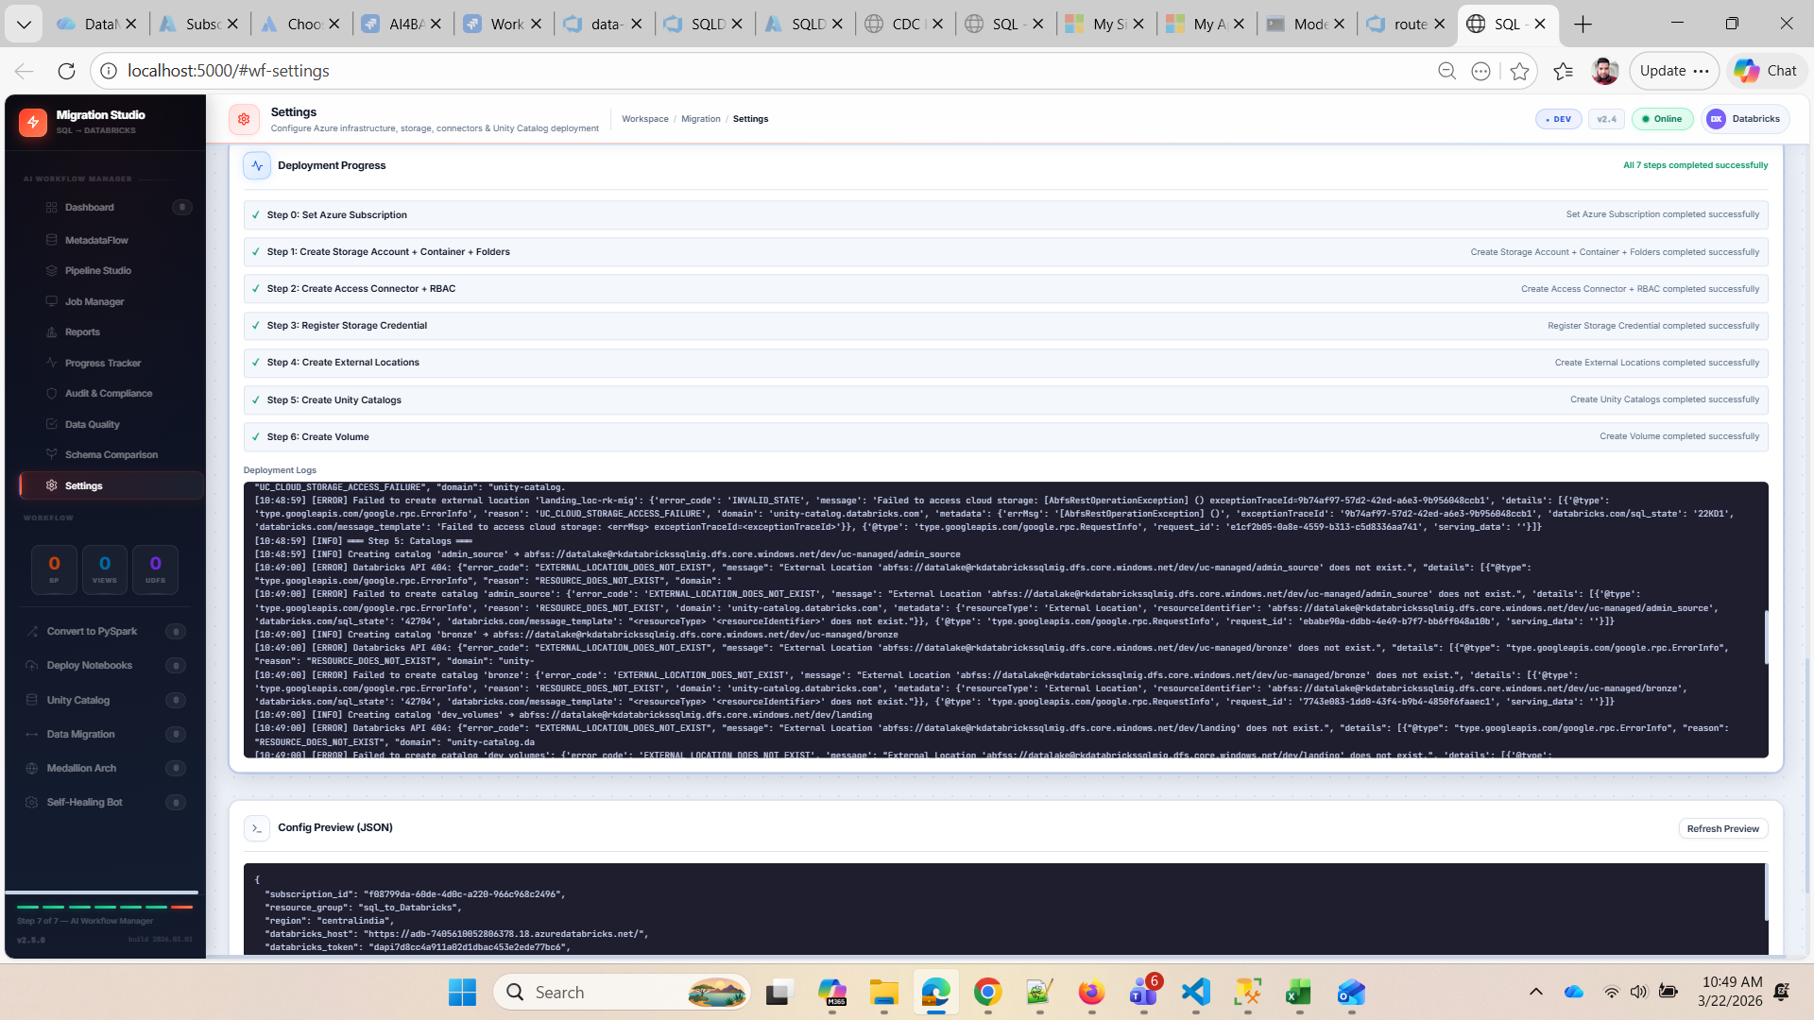

Slide 7
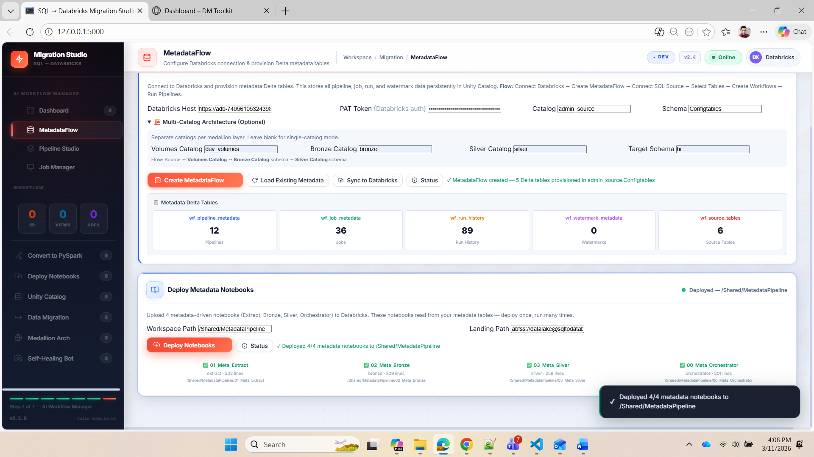
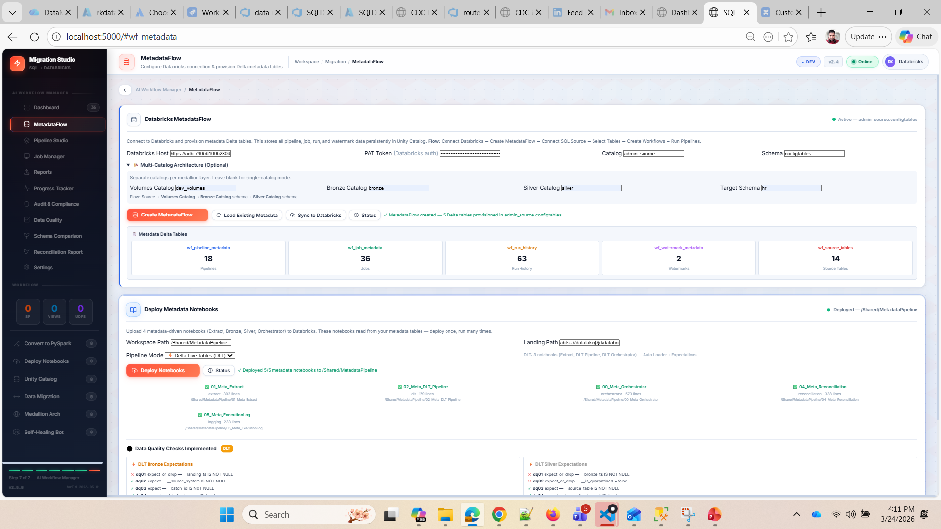

Slide 8
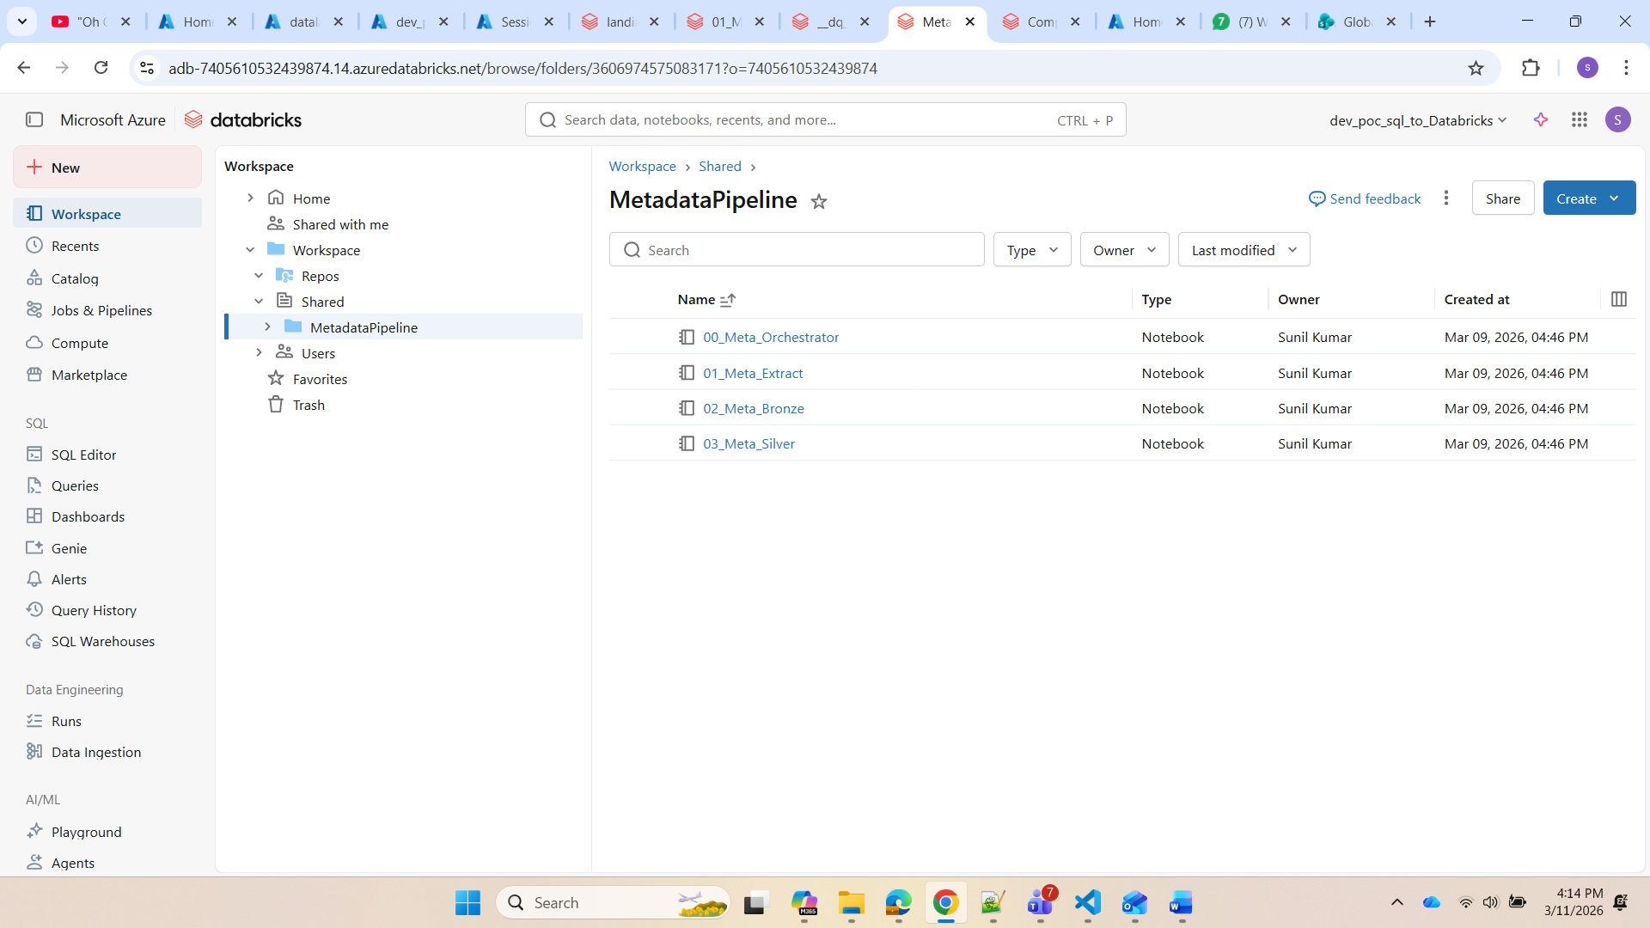
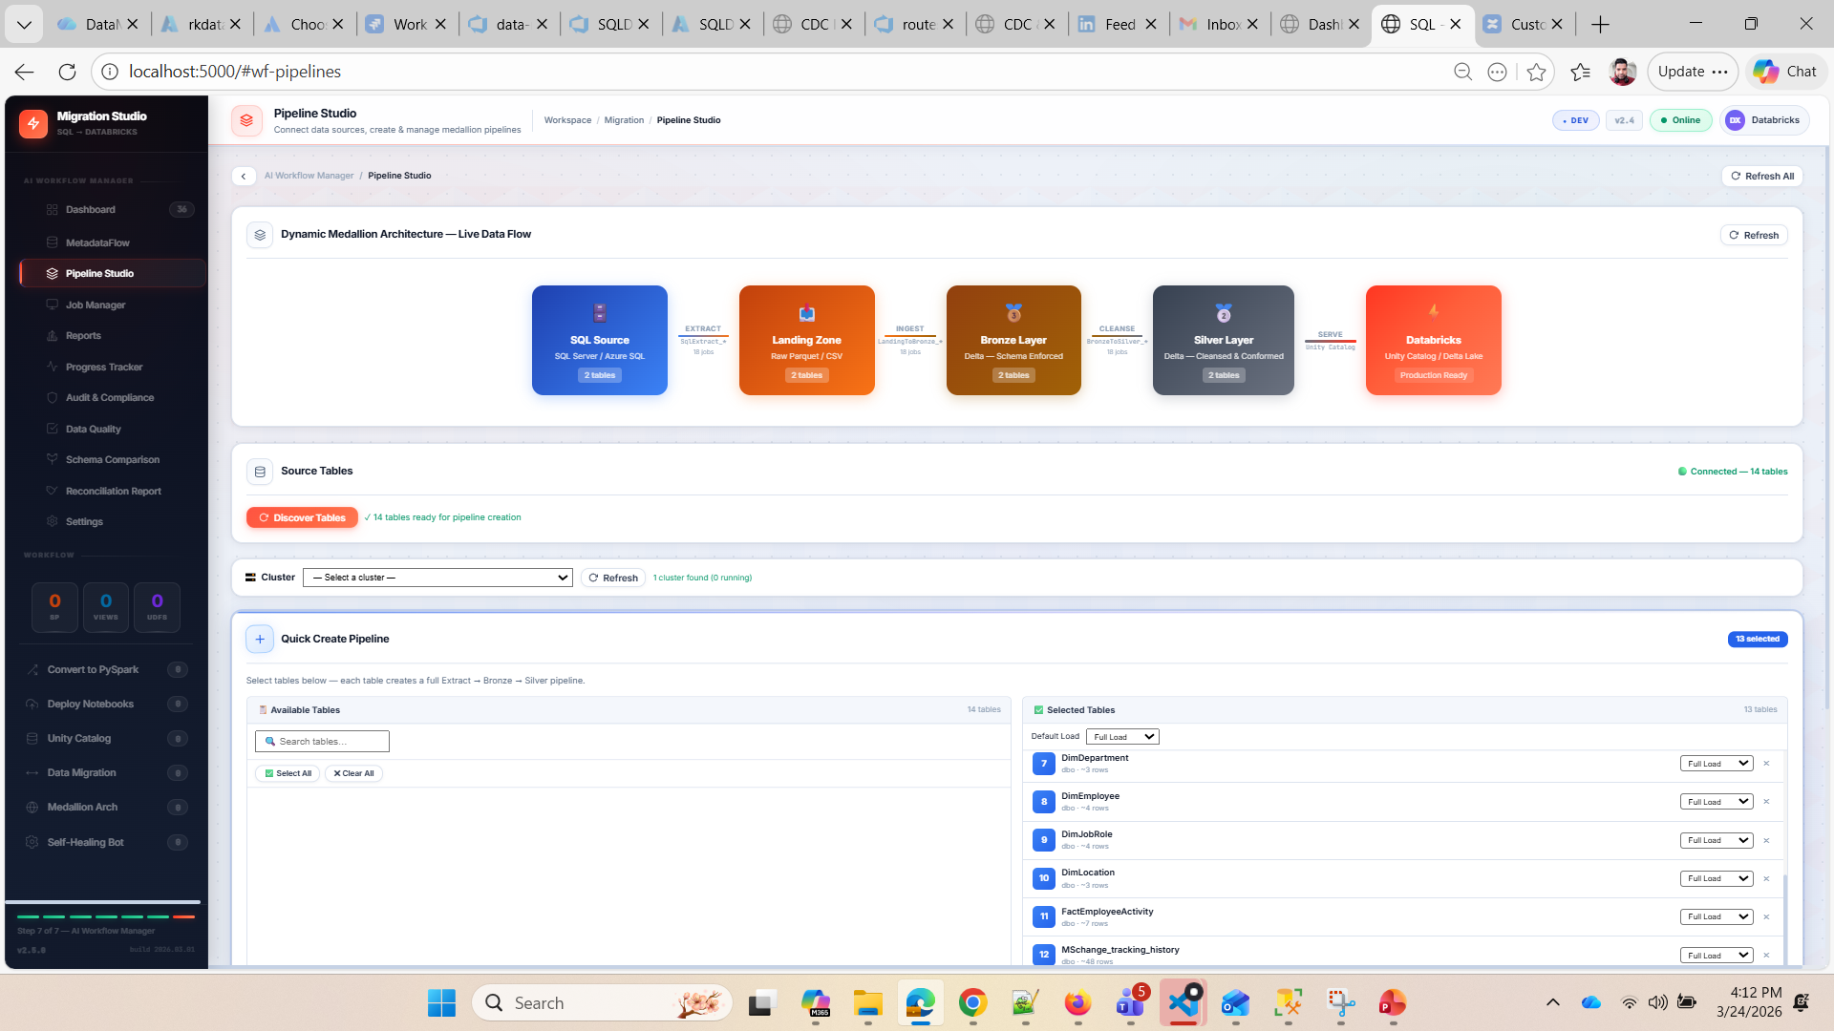

Slide 9
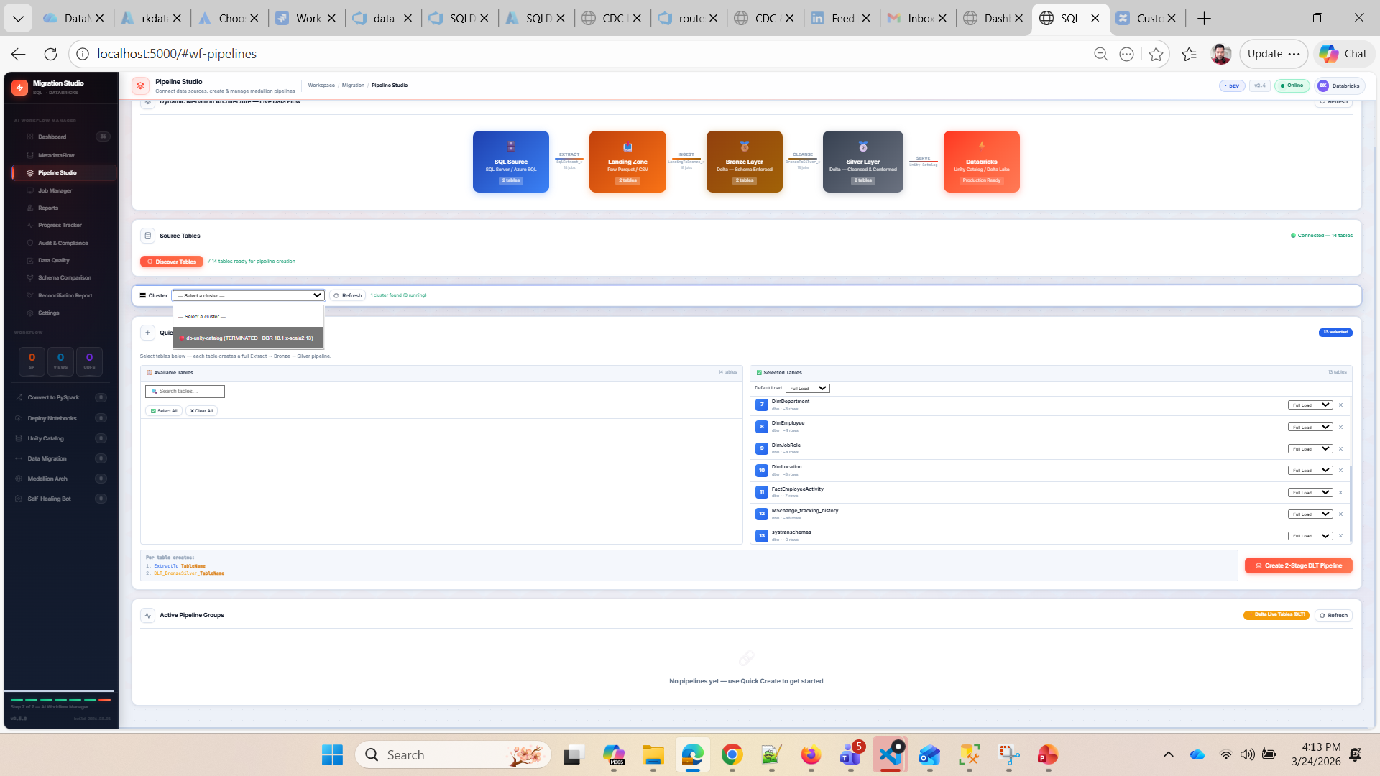

Slide 10
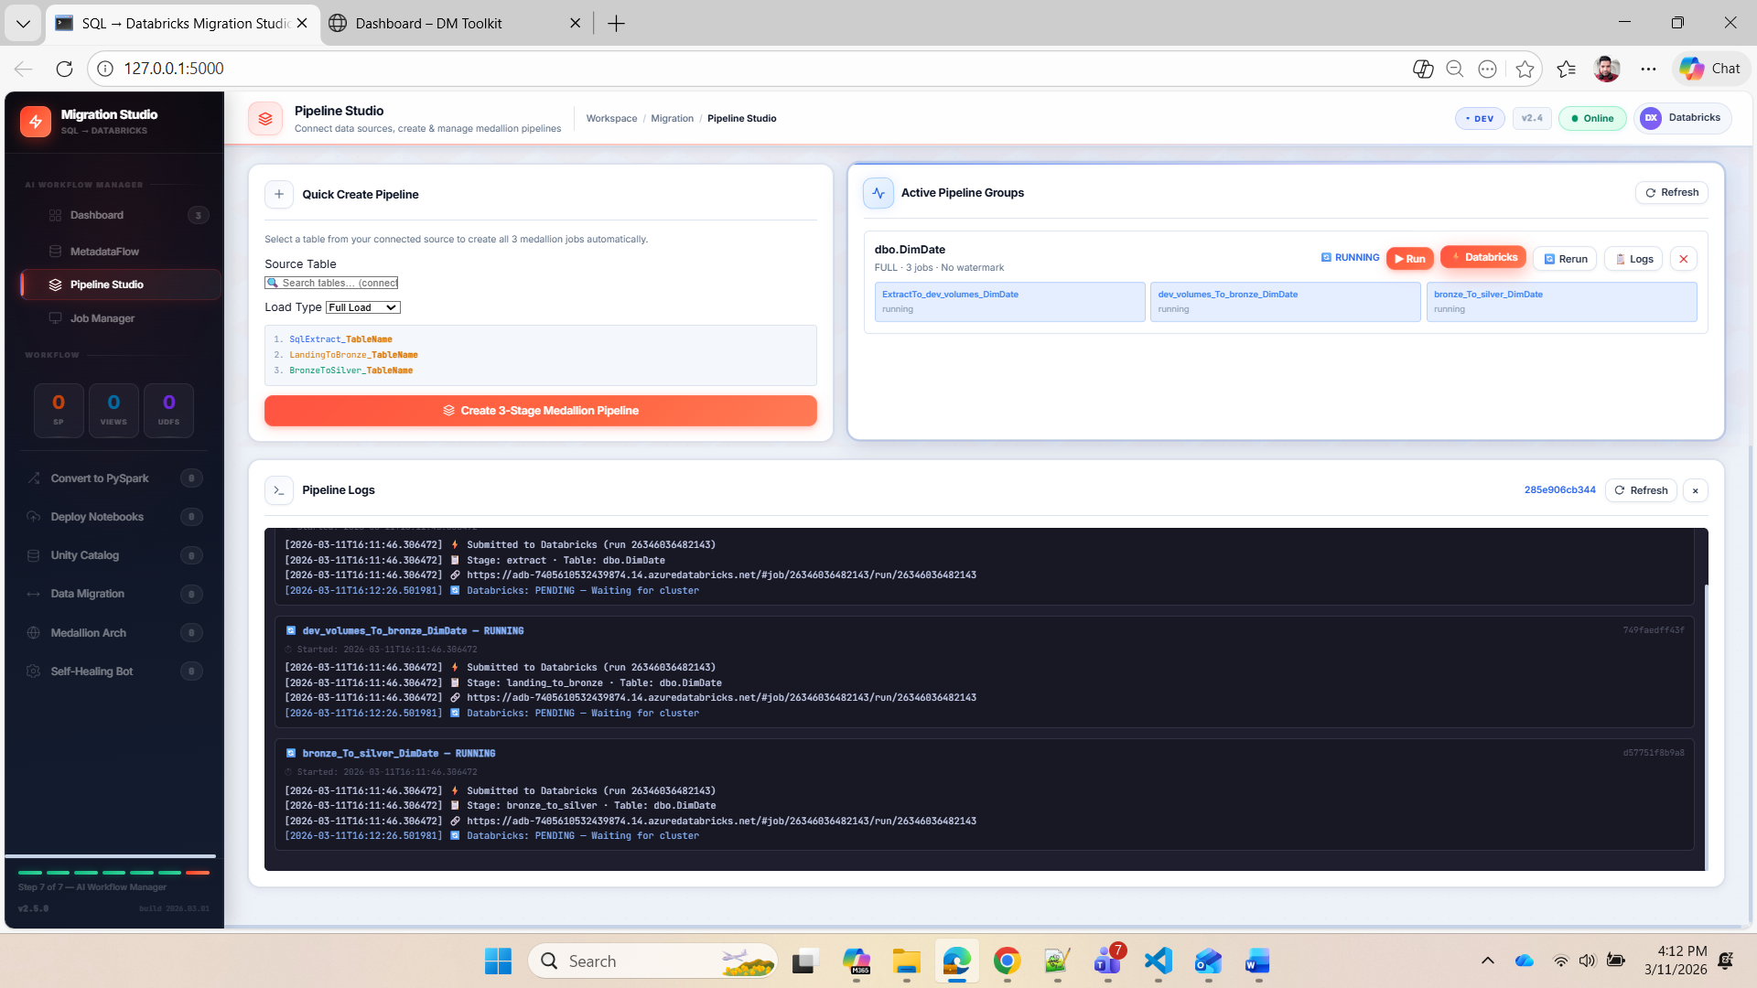

Slide 11
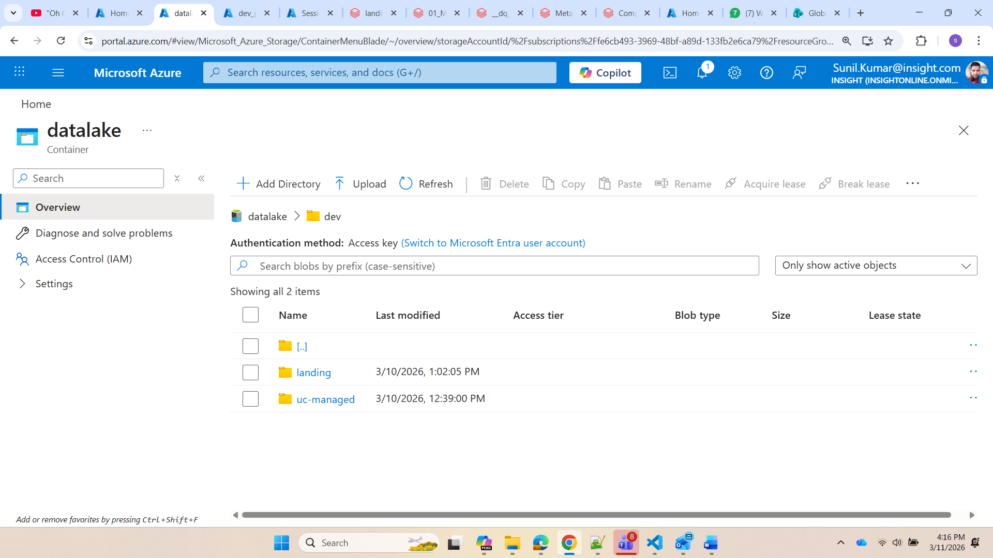

Slide 12
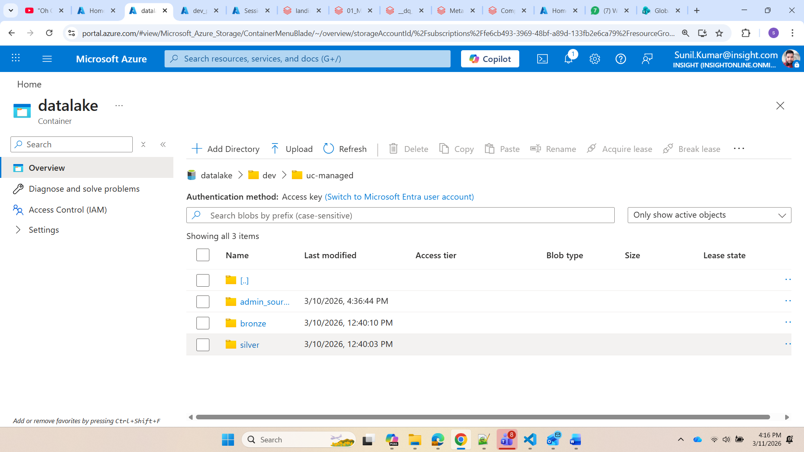
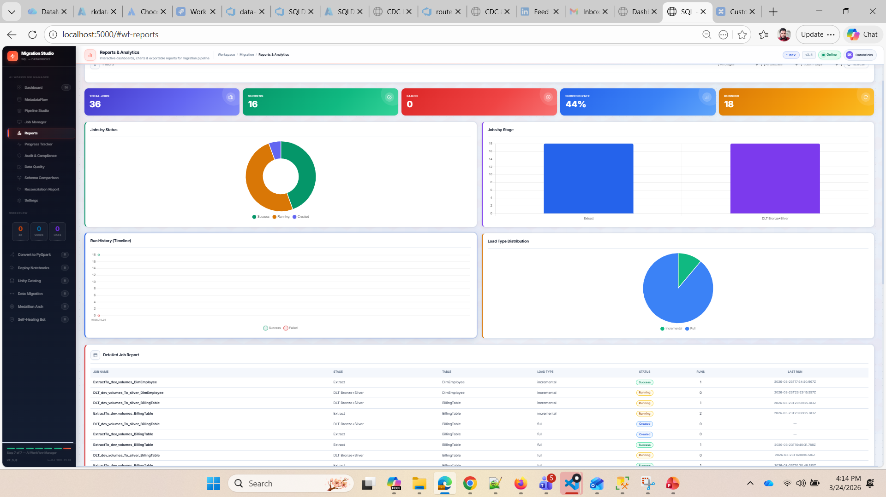

Slide 13
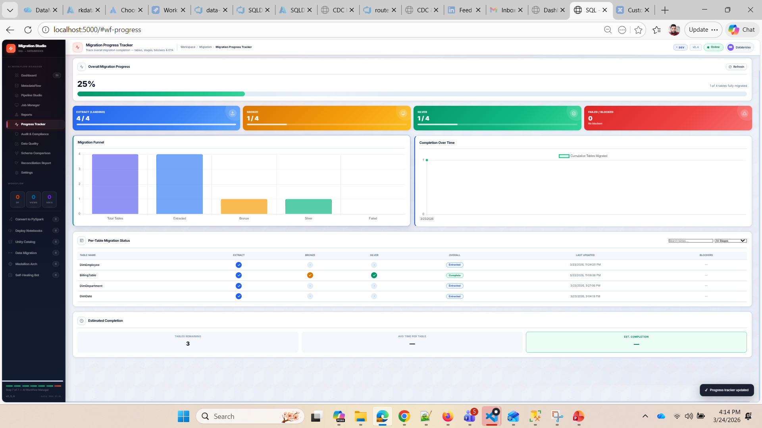

Slide 14
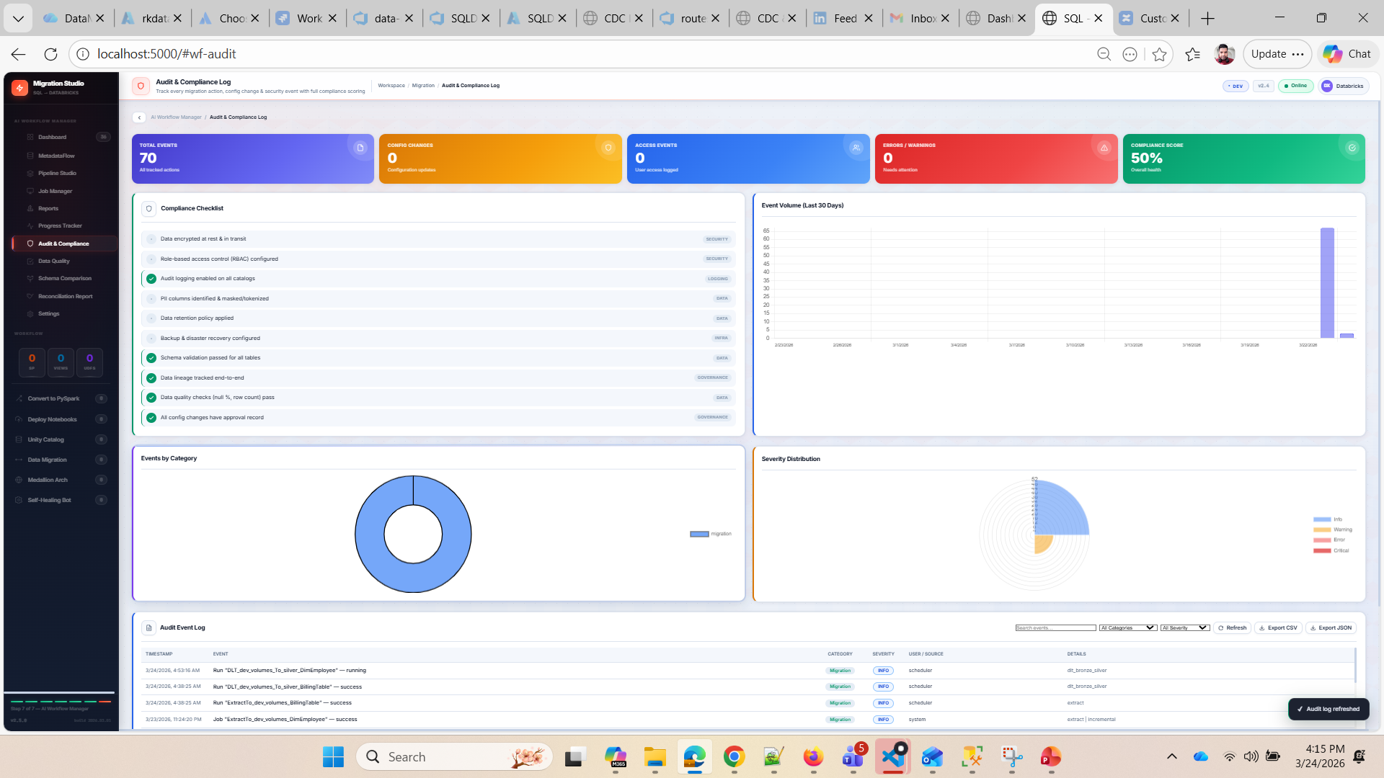

Slide 15
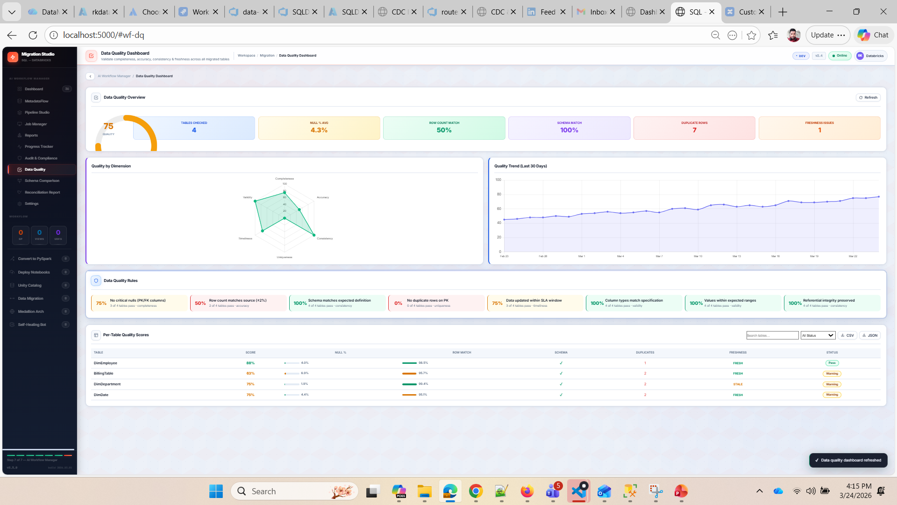

Slide 16
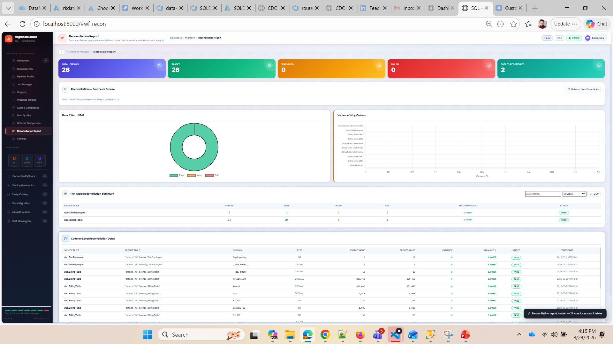

Slide 17
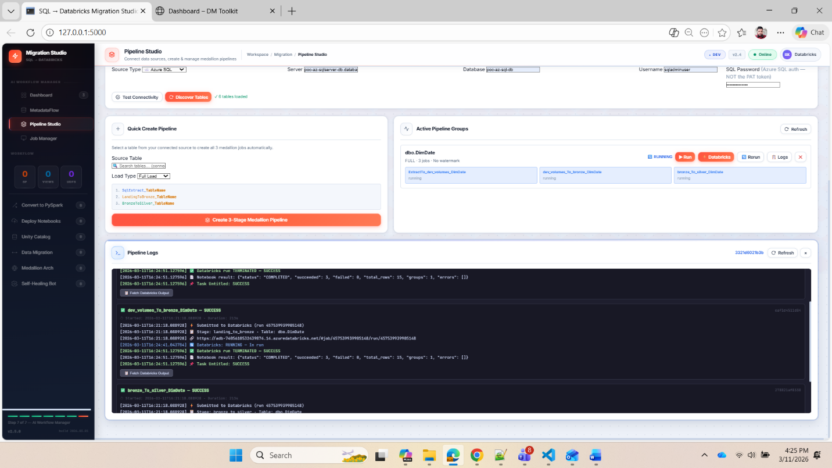
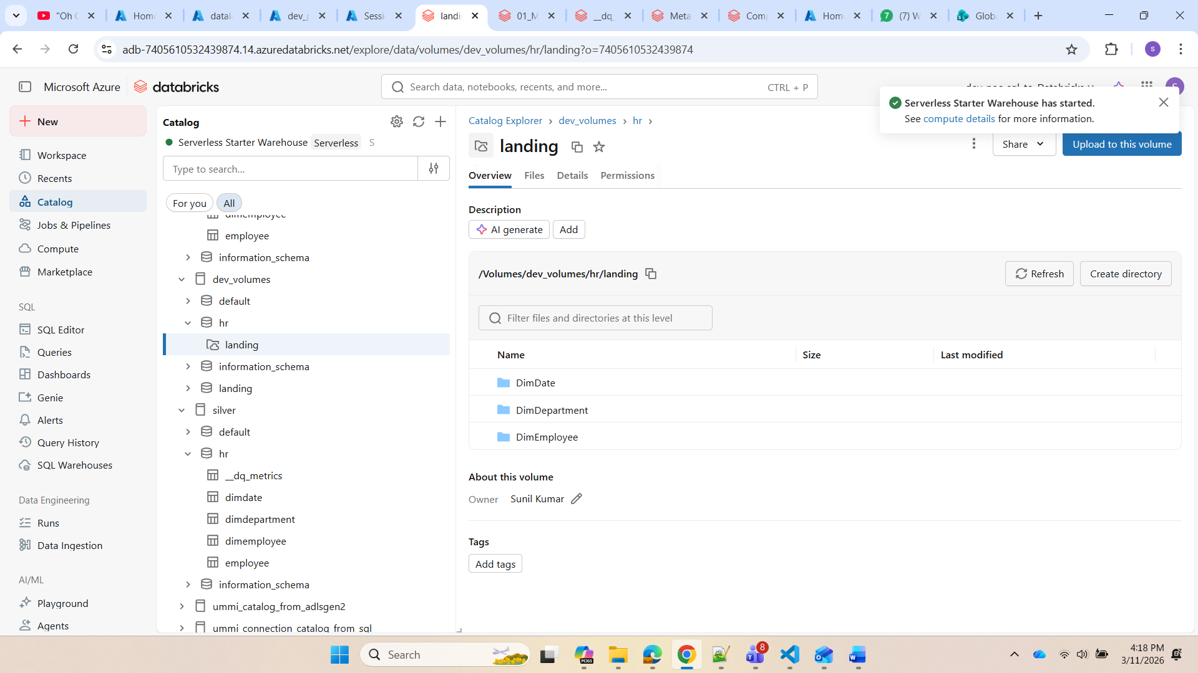

Slide 18
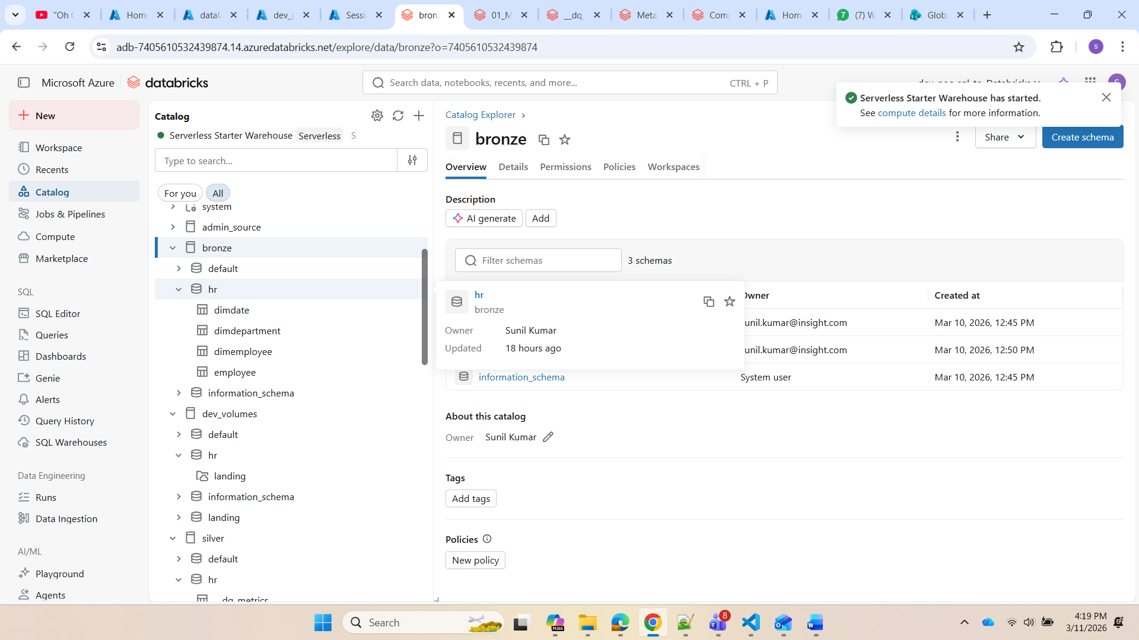

Slide 19
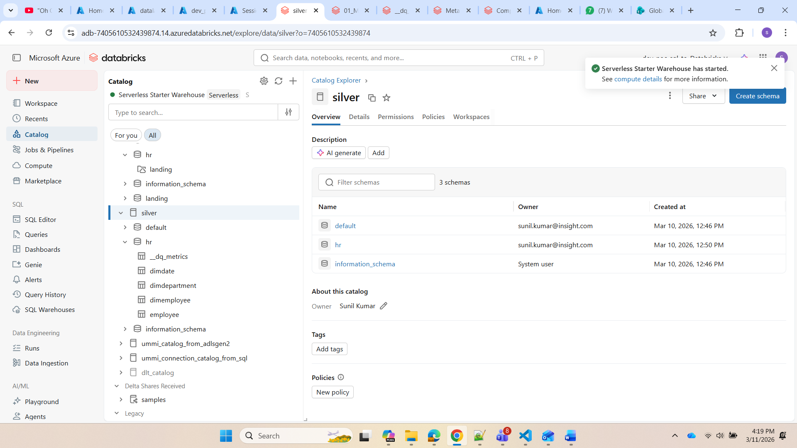

Slide 20
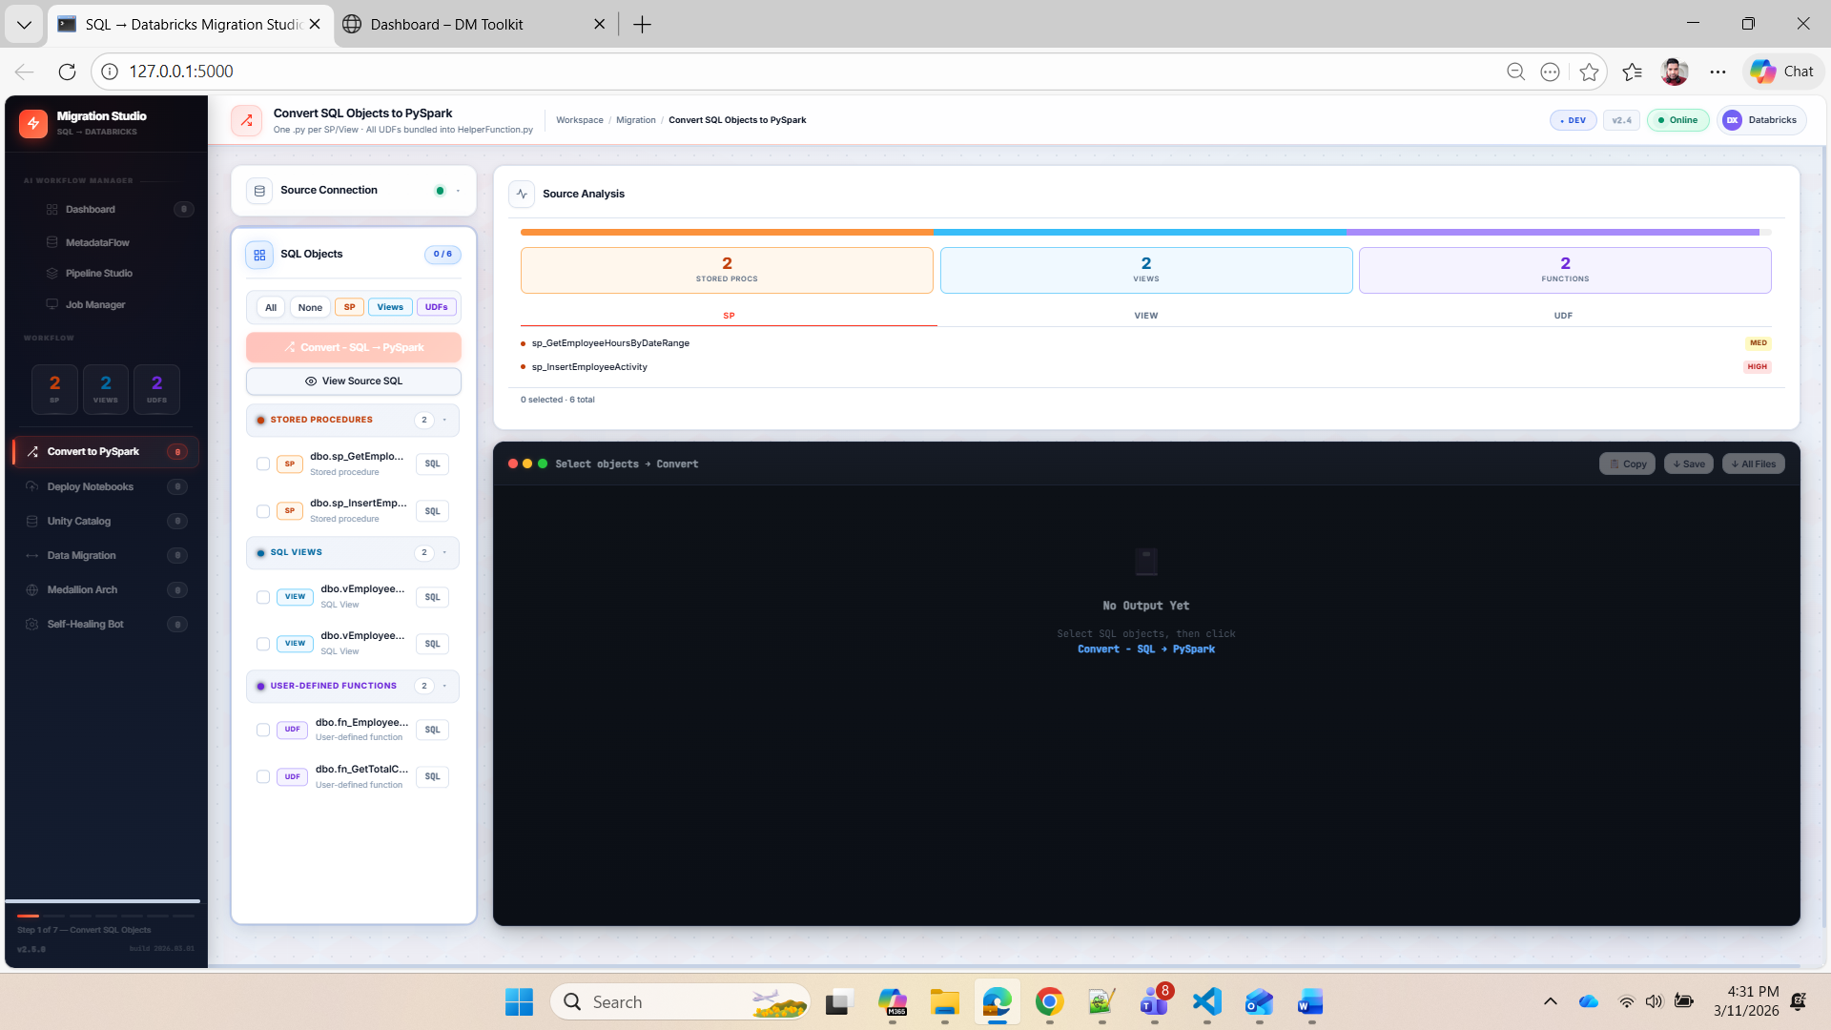

Slide 21
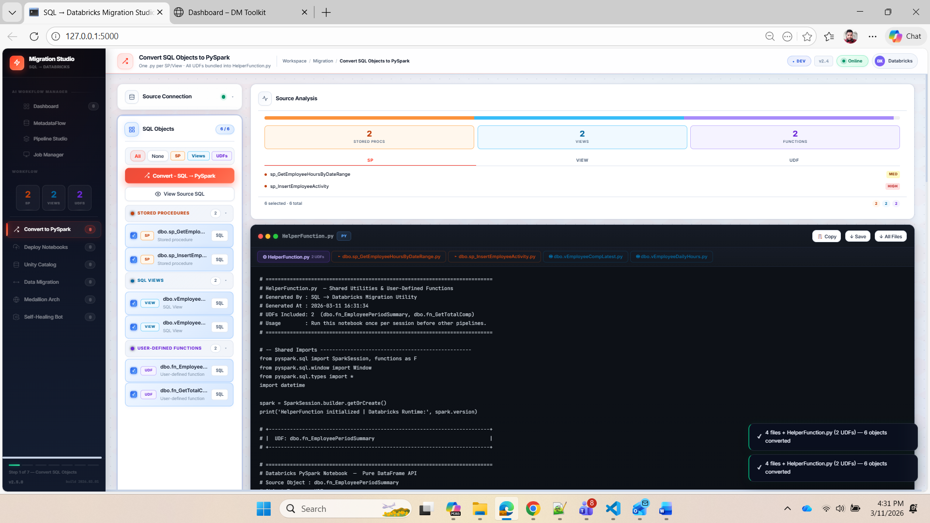

Slide 22
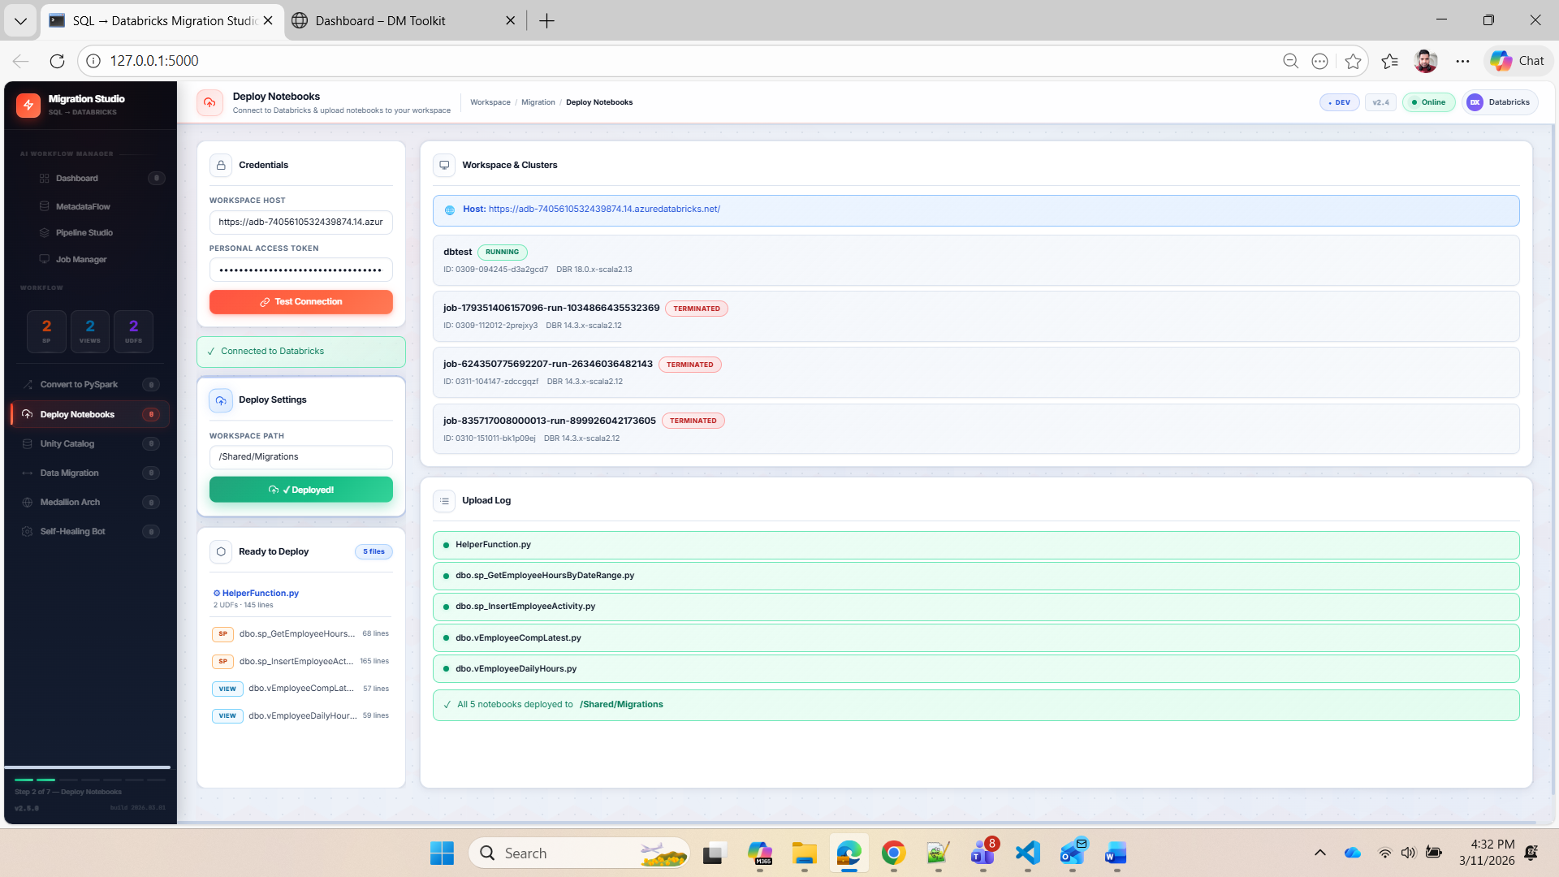

Slide 23
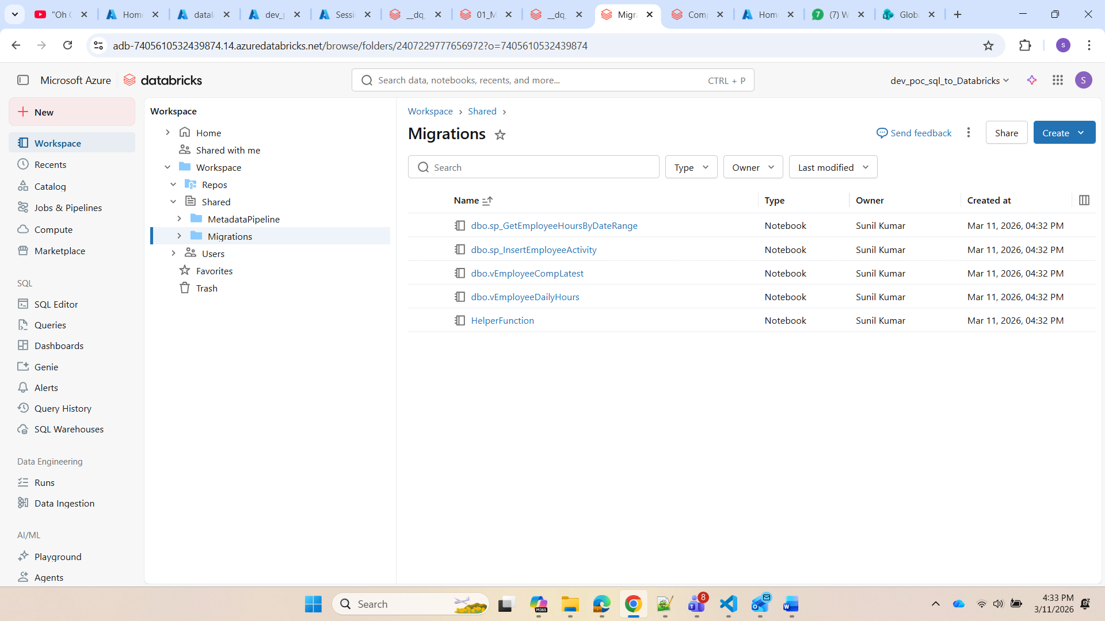

Slide 24
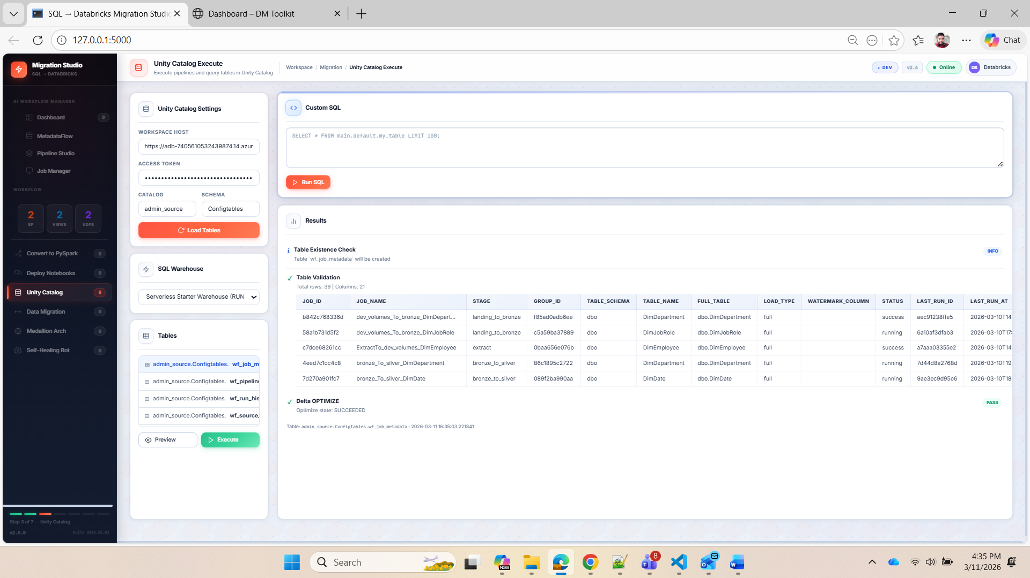

Slide 25
